Slide 1
Prospecting, QUALIFYING and Sponsoring

Slide 2
Prospecting, Qualifying
Sponsoring all starts with
a mental decision

Slide 3
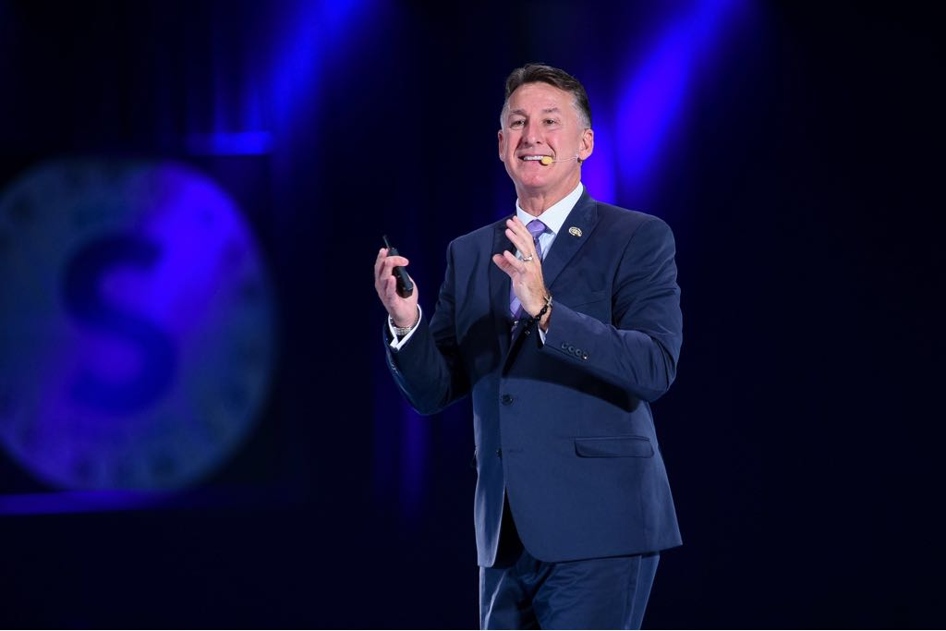
Add Two Possibilities/Day
Call One/Day
Show Two Business Plans/Week

Slide 4
Warm Market
Friends, family, neighbors, teammates
High school classmates
College classmates
Organizations, associations, or groups that you belong to or have belonged to
Work colleagues (current and past positions)
Building A Names List
Social media

Slide 5
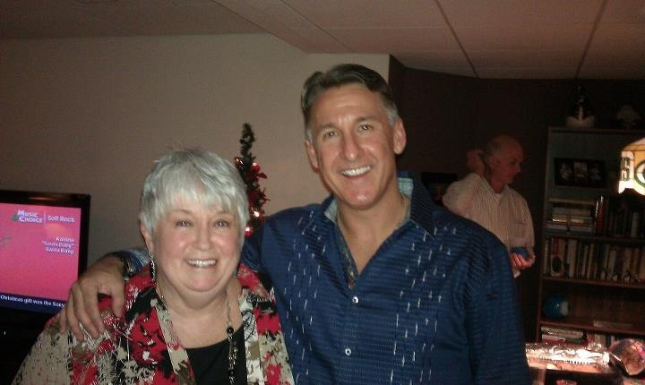

Slide 6
Names List
Exercise
3 Minutes

Slide 8
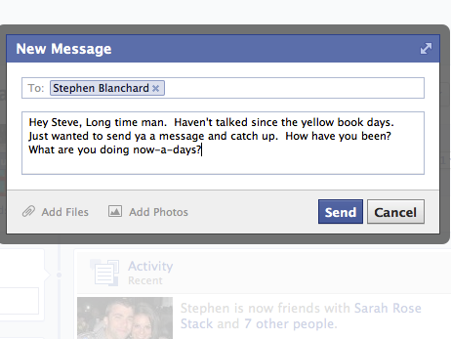
Social Media Prospecting
Expand possibilities easily, message two people per day minimum
Communicate and add two new conversations
per day in less than five minutes
Warm up cold markets
Ask lots of questions – prospect don’t recruit
Use this to take MASSIVE ACTION to ensure your success based on the law of probability

Slide 9
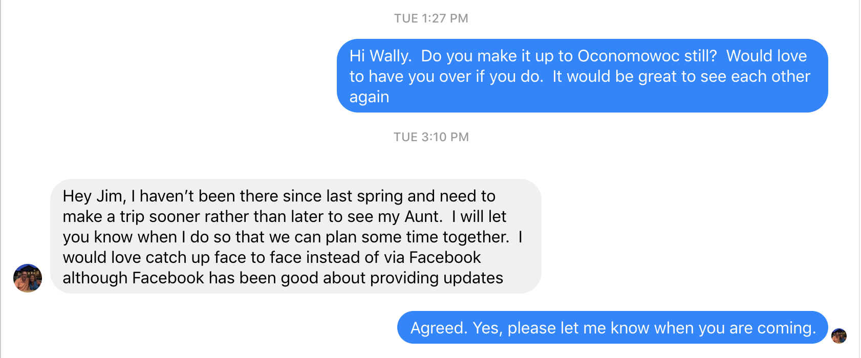

Slide 10
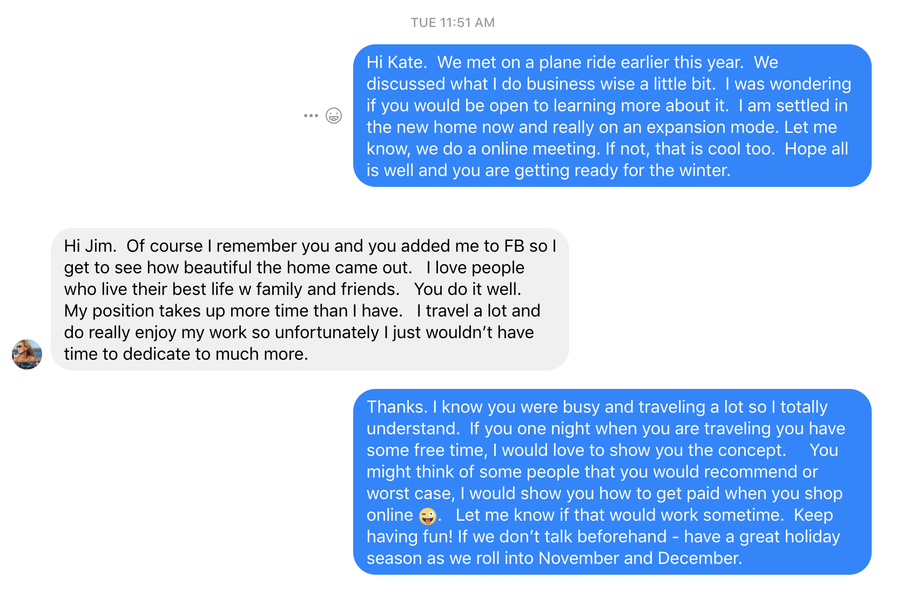
FB MESSAGE

Slide 11
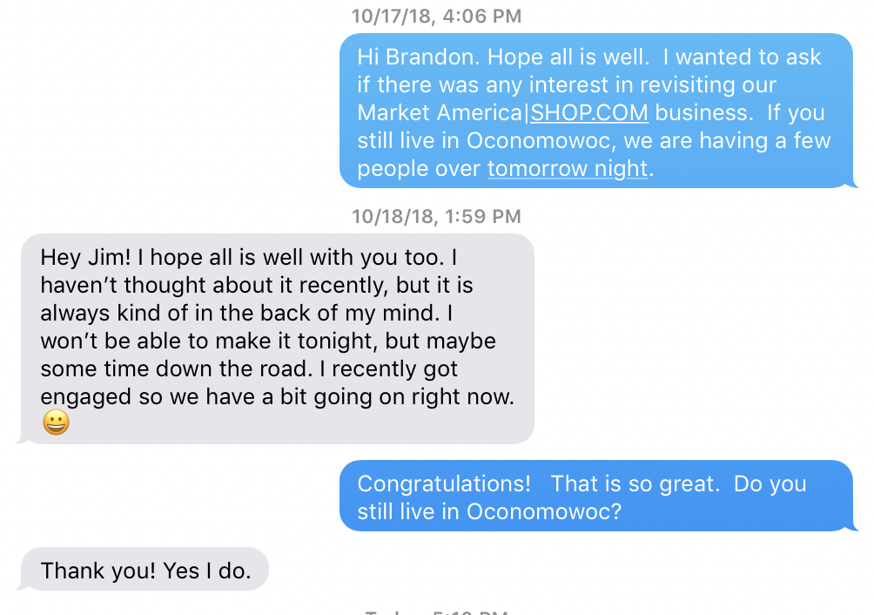
TEXT MESSAGE

Slide 12
Facebook
Exercise
Add 5 names
Message two

Slide 13
2 - TOP 10 LISTS
After building your list, prioritize the list
People who will let you show them the plan
Your best prospects
Approaches are determined for the top 10 with your business partner
Continue to build relationships with everyone on your list

Slide 14
Adding to your names list is just as important as building it
Possibilities Are Everywhere
Add two names per day

Slide 15
Always be asking questions!
What do you do for a living?
How long have you worked here?
How long have you lived in the area?
What brought you to this area?
What does your spouse do?
Do you have family in the area?
Do you do this full time?
Do you keep your options open?

Slide 16
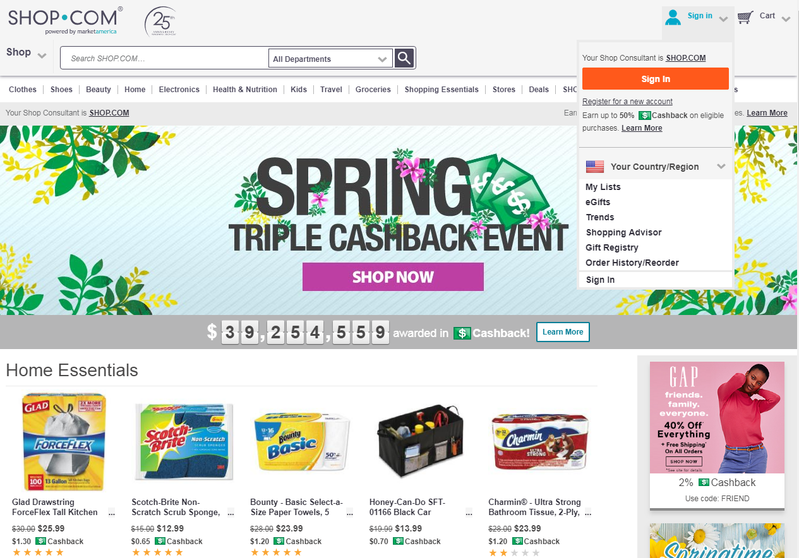
Answer
We are a product brokerage and internet marketing company called SHOP.COM. Have you heard of us?
The answer should be short and intriguing
The goal is to start or continue the dialogue

Slide 17
What is it?
We are really a hybrid between franchising, internet marketing and traditional business. We take the best of each to create an entirely new concept called the UnFranchise
What do I do?
I teach people how to make a lot of money online with a new concept called the UnFranchise.
Jim Winkler

Slide 18
What is it?
It’s a way to make a lot of money online
What do I do?
I teach people how to make a lot of money online
Elizabeth Weber-Walliser

Slide 19
What is it?
It’s a product brokerage and internet marketing company that helps people turn their spending into earning and create a Shopping Annuity.
What do you do?
I help people create an ageless lifestyle with wellness solutions
Jacki Blasko

Slide 20
What is it?
It’s called the Shopping Annuity. Have you ever heard of it?
Basically I help people take money they are already spending on every day stuff and turn it into a business that pays them on an ongoing basis.
Colton Whited

Slide 21
What is it?
Have you ever heard of the Shopping Annuity?
It’s a way of taking the dollars you are already spending and putting them into a business for yourself. I can’t believe you have never heard of it.
Ke Zhu

Slide 22
What is it?
A business system for people who want more income but don’t want another job
Lynn Mitschke

Slide 23
What is it
Exercise
Pick a partner

Slide 24
Call workshops
TEAMWORK
Working together gets results

Slide 25
WHY DO CALL WORKSHOPS WORK?
It is scheduled
Power of positive energy of two or more people
Coaching
Starts a new person fast
Accountability
Continues momentum in the business

Slide 26
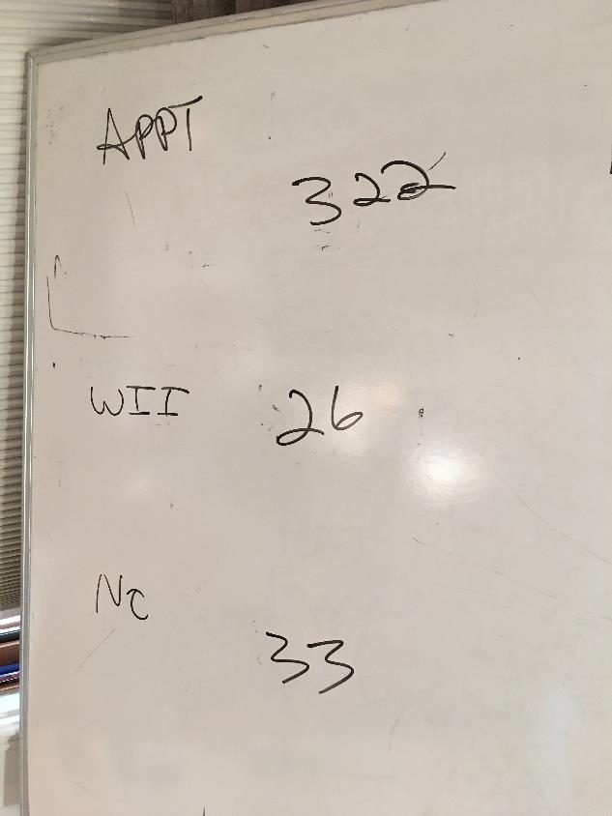
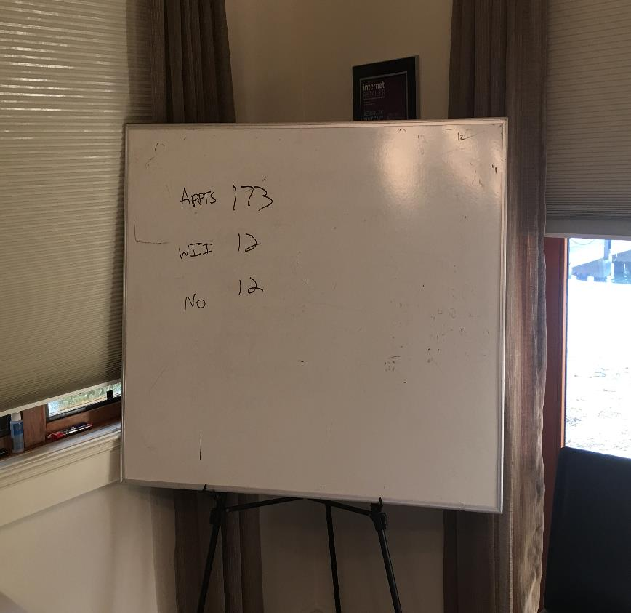

Slide 27
FREQUENTLY ASKED QUESTIONS:
What happens if I get a voice mail?
Can I text someone to let them know that I will be calling?
What if a call starts to go too long?
What if someone keeps asking questions?
Can I do a call workshop from a distance?

Slide 28
Ways of asking for the appointment
Referral
Evaluation
Direct (direct indirect)

Slide 29
Direct (direct indirect)

Slide 30
Key Words/Phrases
Help
Expanding/Growing
No Pressure/Information only
May or may not be interested
Willing to evaluate
Lead

Slide 31
Texts before the calls:
Are you available for a quick phone call?
Can I give you a quick call?
Chat? Available?

Slide 32
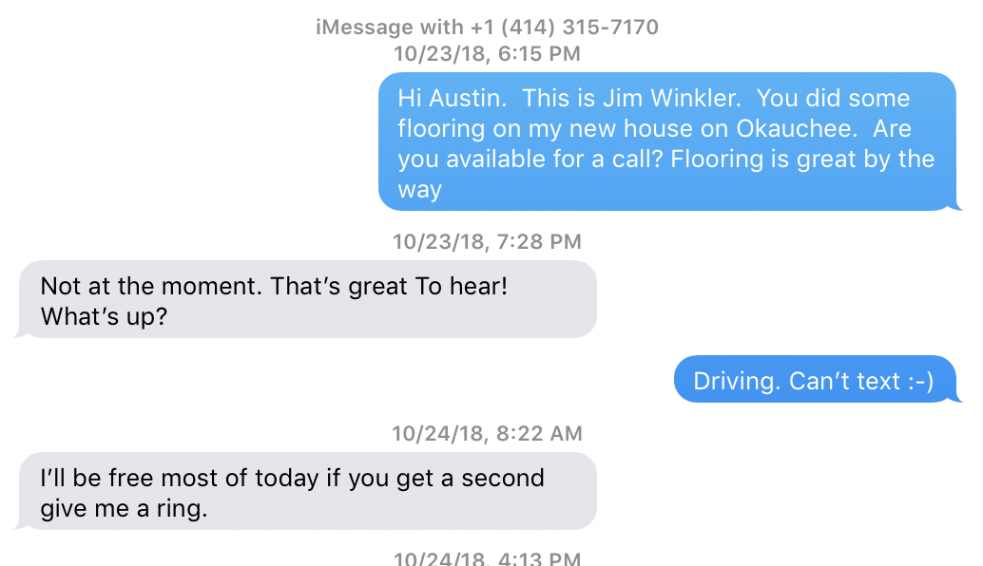

Slide 33
Make the calls Hit key points
I only have a second,
the reason I’m calling is _____
You may or may not be interested, either way is fine with me
1
4
Edify (you may know the right people)
Can you help me out?
2
5
I want to get together for coffee (Could be with or without your business partner)
If the date doesn’t work – ask, “When is the soonest we can get together”
3
6
Do you see anything in your schedule between now and then that would prevent you from keeping our appointment?
7

Slide 34
Role Playing

Slide 35
Setting Appointments
Exercise
Pick a partner

Slide 36
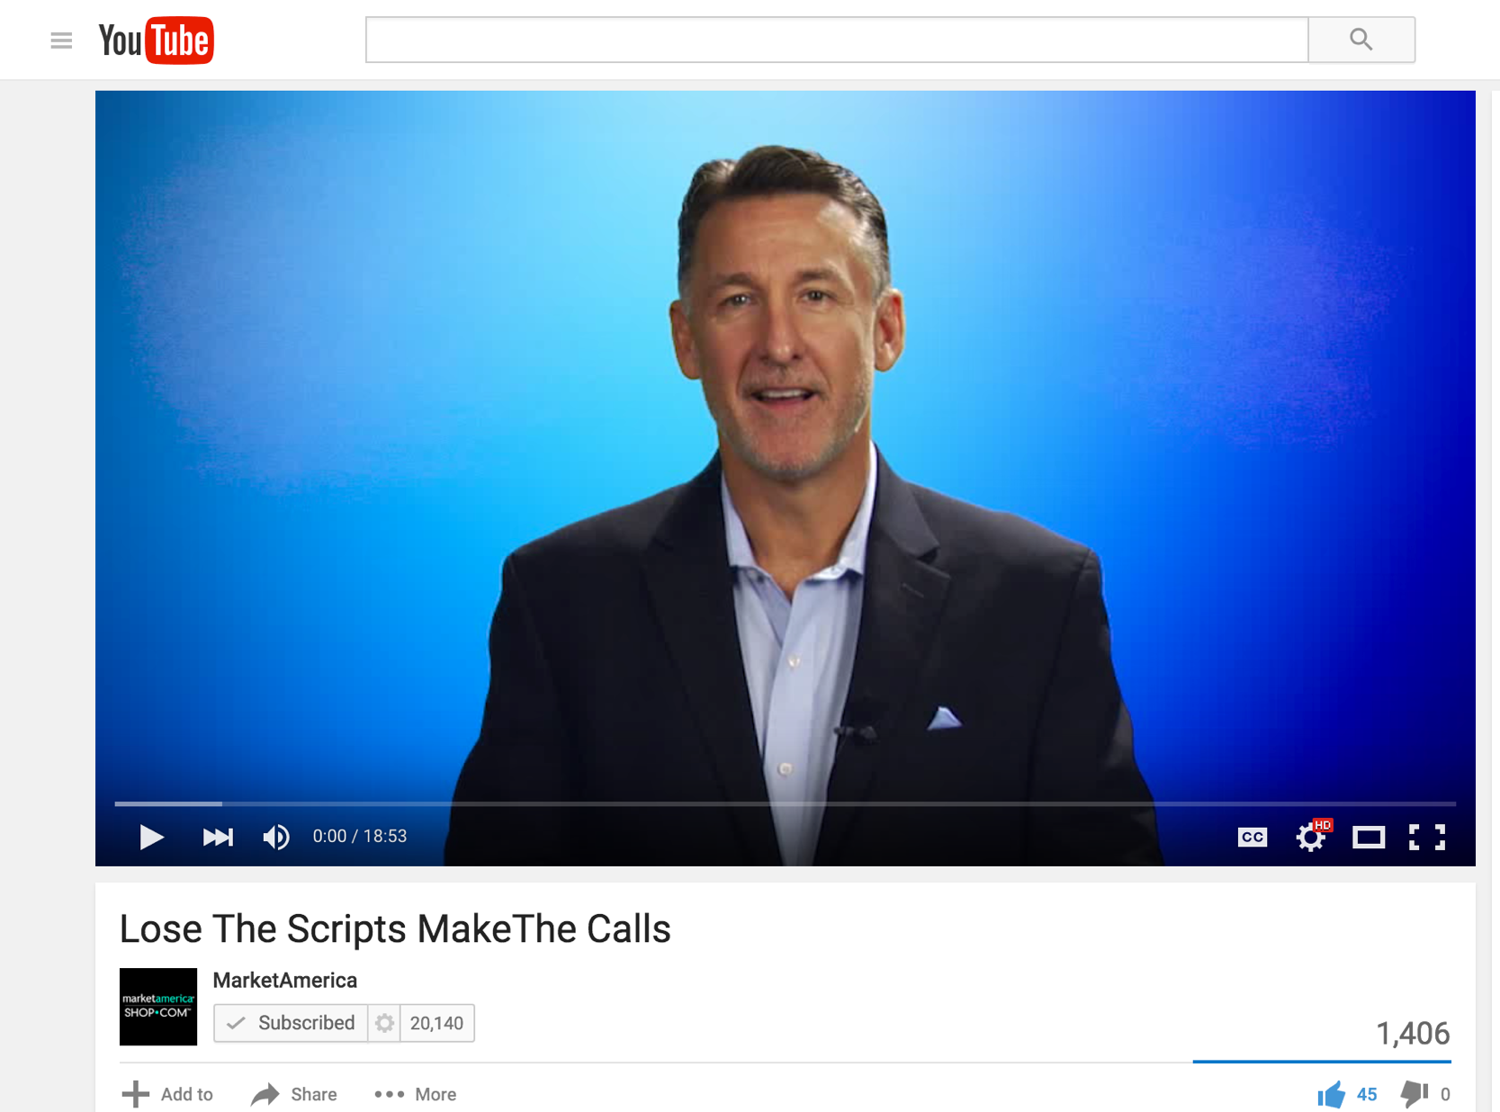

Slide 37
Talking in Themes

